Slide 1
Relational Data Model
Unit - 2

Slide 2
Relational Data Model
Relational data model is the primary data model for commercial data- processing applications.
A relational database consists of a collection of tables, each of which is assigned a unique name.
A row in a table represents a relationship among a set of values. Thus, a table is an entity set and a row is an entity/tuples.
The columns or properties are called attributes. For each attribute, there is a set of permitted values, called the domain of that attribute. Same domain can be shared by more than one attribute.
Degree is the number of attributes in the relation/ table, where as Cardinality is the number of tuples or rows in the relation/table.

Slide 3
The attribute values are required to be atomic, i.e. indivisible.
Let D1, D2, and D3 are the domains. Any row of the table consists of a 3-tuple (v1, v2, v3) where v1 ∈ D1, v2 ∈ D2 and v3 ∈ D3. Thus, the table will contain only a subset of the set of all possible rows. Therefore, the table is a subset of D1 x D2 x D3.
Each attribute of a relation has a unique name.
NULL Value is a domain value which is a member of any possible domain.

Slide 4
Relational data model is the primary data model for commercial data- processing applications. Database Schema is the logical design of the database. If (a1, a2 ...an ) be the attributes, then the relation schema will be R=(a1,a2 ...an )
Database Instance is the snapshot of the data in the database at a given instant of time
Relation is denoted by lower case names and Relation Schema is the name beginning with an uppercase letter
A relational database schema S is a set of relation schemas S = {R1, R2, ..., R_{m}} and a set of integrity constraints IC. A relational database state DB of S is a set of relation states DB = {r1, r2, ..., r_{m}} such that each r^{i} is a state of R_{i} and such that the r_{i} relation states satisfy the integrity constraints specified in IC.

Slide 5
Relational Database
Relational database is a database consisting of multiple relations or tables. The information about an enterprise is broken up into parts, with each relation storing one part of the information
The normalization process deals with how to design relational schemas.

Slide 6
Summary
Attribute: Each column in a Table. Attributes are the properties which define a relation. e.g., Student_Rollno, NAME,etc.
Tables – In the Relational model the, relations are saved in the table format. It is stored along with its entities. A table has two properties rows and columns. Rows represent records and columns represent attributes.
Tuple – It is nothing but a single row of a table, which contains a single record.
Relation Schema: A relation schema represents the name of the relation with its attributes.
Degree: The total number of attributes which in the relation is called the degree of the relation.

Slide 7
Cardinality: Total number of rows present in the Table.
Column: The column represents the set of values for a specific attribute.
Relation instance – Relation instance is a finite set of tuples in the RDBMS system. Relation instances never have duplicate tuples.
Relation key - Every row has one, two or multiple attributes, which is called relation key.
Attribute domain – Every attribute has some pre-defined value and scope which is known as attribute domain

Slide 8
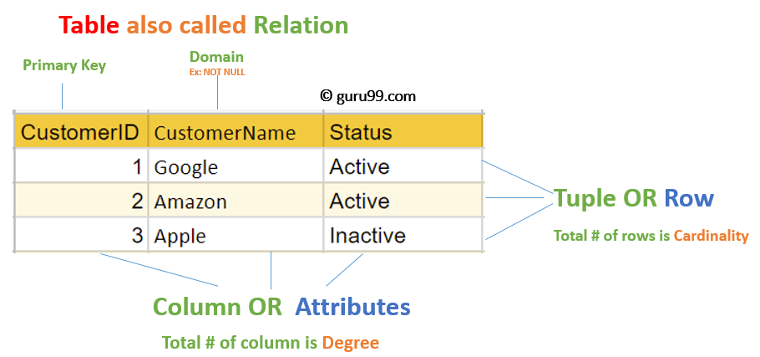

Slide 9
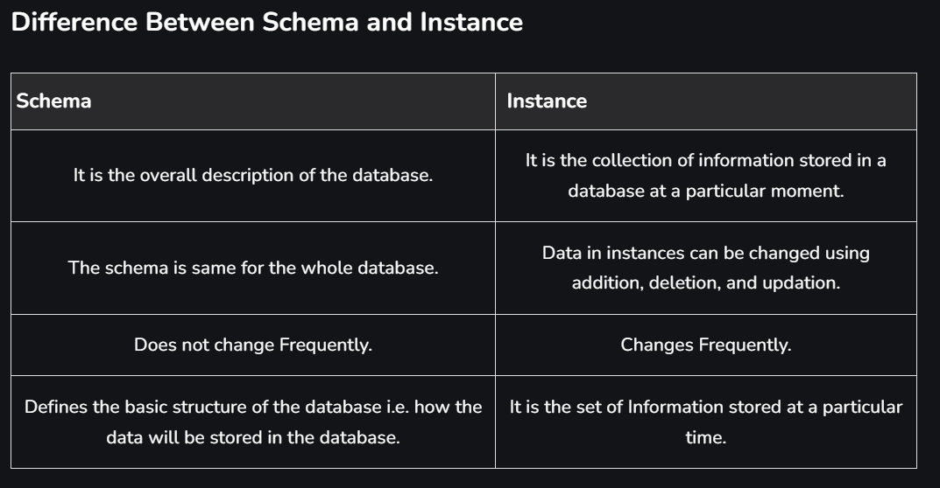
Schema-instance distinction

Slide 10
Relational Data Integrity
Candidate key is an attribute or set of attributes that can uniquely identify a row or tuple in a table. Let R be the relation with attributes a1, a2 ... a^{n} . The set of attributes of R is said to be a candidate key of R iff the following two properties holds:
Uniqueness: At any given time, no two distinct tuples or rows of R have the same value for ai , the same value for aj...a^{n}
Minimality: No proper subset of the set (ai , aj ... a^{n} ) has the uniqueness property

Slide 11
Constraints
Every relation has some conditions that must hold for it to be a valid relation. These conditions are called Relational Integrity Constraints. There are three main integrity constraints −
Key constraints ( Entity Integrity Constraint/ primary Key Constraint)
Domain constraints
Referential integrity constraints

Slide 12
Key Constraints
There must be at least one minimal subset of attributes in the relation, which can identify a tuple uniquely. This minimal subset of attributes is called key for that relation. If there are more than one such minimal subsets, these are called candidate keys.
Key constraints force that −
in a relation with a key attribute, no two tuples can have identical values for key attributes.
a key attribute can not have NULL values.
Key constraints are also referred to as Entity Constraints.

Slide 13

Entity Integrity Constraint
It states that no primary key value can be null. This is because the primary key is used to identify individual tuple in the relation. So we will not be able to identify the records uniquely containing null values for the primary key attributes. This constraint is specified on one individual relation.
Suppose that we denote one such subset of attributes by SK; then for any two distinct tuples t1 and t2 in a relation state r of R, we have the constraint that:

Slide 14
Example : Let R be the Table
Note:
1) „#‟ identifies the Primary key of a relation.
In the relation R above, the primary key has null values in the tuples t1 & t3. NULL value in primary key is not permitted, thus, relation instance is an invalid instance.
A# | B | C
Null | B1 | C1
A2 | B2 | C2
Null | B3 | C3
A4 | B4 | C3
A5 | B1 | C5

Slide 15
Domain constraints
Domain constraints specify that within each tuple, the value of each attribute A must be an atomic value from the domain dom(A).
The data types associated with domains typically include standard numeric data types for integers (such as short integer, integer, and long integer) and real numbers (float and double-precision float). Characters, Booleans, fixed-length strings, and variable-length strings are also available, as are date, time, timestamp, and money, or other special data types.

Slide 16
Referential Integrity
In relational data model, associations between tables are defined by using foreign keys
A referential integrity constraint is a rule that maintains consistency among the rows of two relations
The rule states that if there is a foreign key in one relation, either each foreign key value must match a primary key value in the other table or else the foreign key value must be NULL
A foreign key that references its own relation is known as recursive foreign key
The linking between the foreign key and primary key allows a set of relations to form an integrated database

Slide 17
Referential Integrity
A# | B | C^
A1 | B1 | C1
A2 | B2 | C2
A3 | B3 | C3
A4 | B4 | C3
A5 | B1 | C5
E | C#
E1 | C1
E2 | C3
E3 | C5
E2 | C2
Note:
1) “#” identifies the Primary key of a relation.
2) “^” identifies the Foreign key of a relation.
In the example above, the value of C^ in every R tuple is matching with the value of C# in some S tuple. If a tuple having values (A6, B2, C4) is added then it is invalid since referenced relation S doesn‟t include C4. Thus, it will be a violation of referential integrity constraint.

Slide 18
Operational Constraints
These are the constraints enforced in the database by the business rules or real world limitations.
There are three basic operations to be performed on relations:
Insertion
Deletion
Update

Slide 19
The INSERT Operation
The insert operation allows us to insert a new tuple in a relation. When we try to insert a new record, then any of the following four types of constraints can be violated:
Domain constraint: If the value given to an attribute lies outside the domain of that attribute.
Key constraint: If the value of the key attribute in new tuple t is the same as in the existing tuple in relation R.
Entity Integrity constraint: If the primary key attribute value of new tuple t is given as null.
Referential Integrity constraint: If the value of the foreign key in t refers to a tuple that doesn‟t appear in the referenced relation.

Slide 20
Dealing with constraints violation during insertion:
If the insertion violates one or more constraints, then two options are available:
Default option: - Insertion can be rejected and the reason of rejection can also be explained to the user by DBMS.
Ask the user to correct the data, resubmit, also give the reason for rejecting the insertion.
PERSON_ID | NAME | AGE | ADDRESS
1 | Sanjay Prasad | 35 | b-4,Modi Nagar
2 | Sharad Gupta | 30 | Pocket 2, Mayur
 |  |  | Vihar.
3 | Vibhu Datt | 36 | c-2, New Delhi

Slide 21
PERSON_ID | NAME | AGE | ADDRESS
1 | Sanjay Prasad | 35 | b-4,Modi Nagar
2 | Sharad Gupta | 30 | Pocket 2, Mayur
 |  |  | Vihar.
3 | Vibhu Datt | 36 | c-2, New Delhi
(1)Insert<1, ‘Vipin’, 20, ‘Mayur Vihar’> into PERSON
Violated constraint: - Key constraint
Reason: - Primary key 1 already exists in PERSON.
Dealing: - DBMS could ask the user to provide valid PERSON_ID value and accept the insertion if valid PERSON_ID value is provided.
(2)Insert<’null’, ‘Anurag’, 25, ‘Patparganj’> into PERSON
Violated constraint: - Entity Integrity constraint
Reason: - Primary key is „null‟.
Dealing: - DBMS could ask the user to provide valid PERSON_ID value and accept the insertion if valid PERSON_ID value is provided.
(3)Insert<’abc’, ‘Suman’, 25, ‘IP college’> into PERSON
Violated constraint: - Domain constraint
Reason: - value of PERSON_ID is given a string which is not valid.
(4)Insert <10, ‘Anu’, 25, ‘Patpatganj’> into PERSON
Violated constraint: - None

Slide 22
The Deletion Operation
Using the delete operation some existing records can be deleted from a relation. To delete some specific records from the database a condition is also specified based on which records can be selected for deletion.
Constraints that can be violated during deletion
Only one type of constraint can be violated during deletion, it is referential integrity constraint. It can occur when you want to delete a record in the table where it is referenced by the foreign key of another table.
Dealing with Constraints Violation
If the deletion violates referential integrity constraint, then three options are available:
Default option: - Reject the deletion. It is the job of the DBMS to explain to the user why the deletion was rejected.
Attempt to cascade (or propagate) the deletion by deleting tuples that reference the tuple that is being deleted.
Change the value of referencing attribute that causes the violation.

Slide 23
A# |  | B |  | C^
A1 |  | B1 |  | C1
A2 |  | B3 |  | C3
A3 |  | B4 |  | C3
A4 |  | B1 |  | C5
Table1 : R Table 2:Q
C# |  | D
C1 |  | D1
C3 |  | D2
C5 |  | D3

Slide 24
Note:
1)„#‟ identifies the Primary key of a relation.
2)„^‟ identifies the Foreign key of a relation.
(1)Delete a tuple with C# = ‟C1‟ in Q.
Violated constraint: - Referential Integrity constraint
Reason: - Tuples in relation A refer to tuple in Q.
Dealing: - Options available are
Reject the deletion.
DBMS may automatically delete all tuples from relation Q and S with C #
= „C1‟. This is called cascade detection.
3) The third option would result in putting NULL value in R where C1 exist, which is the first tuple R in the attribute C.

Slide 25
Update Operations and Dealing with Constraint Violations
Update operations are used for modifying database values. The constraint violations faced by this operation are logically the same as the problem faced by Insertion and Deletion Operations. Therefore, we will not discuss this operation in greater detail here.

Slide 26
Database Languages
DDL (Data Definition Language)
DDL is used to define the conceptual schema. The definition includes the information of all the entity sets and their associated attributes as well as the relationships between the entity sets.
The data values stored in the database must specify certain consistency constraints. The database systems check these constraints every time the database is updated.
The output of the DDL is placed in the Data Dictionary which contains the metadata (data about data).
The data dictionary is considered to be a special type of table, which can only be accessed and updated by the database system itself.
The database system consults the data dictionary, before querying or modifying the actual data, for the validation purpose.
CREATE, ALTER, DROP, RENAME & TRUNCATE

Slide 27
DML (Data Manipulation Language)
DML is used to manipulate data in the database.
A query is a statement in the DML that requests the retrieval of data from the database . SELECT, INSERT, UPDATE & DELETE
DCL (Data Control Languages)
DCL allows in changing the permissions on database structures
GRANT & REVOKE
TCL (Transaction Control Language)
TCL allows permanently recording the changes made to the rows stored in a table or undoing such changes
COMMIT, ROLLBACK & SAVEPOINT

Slide 28
CODD’s Rule
Codd’s rules are a set of 12 rules proposed by E. F. Codd designed to define what is required from a database management system in order for it to be considered relational, i.e. RDBMS. Any database that satisfies even six rules may be categorized as RDBMS.
Rule0: A relational system should be able to manage databases, entirely through its relational capabilities
Rule1: Information representation: The entire information is explicitly and logically represented by the data values of the tables in the relational data model
Rule2: Guaranteed access: In relational model, at each cell, i.e. the interaction of each row and column, it will have one and only one value of data (or NULL value). Each value of data must be addressable via the combination of a table name, primary key value and the column name

Slide 29
Rule3: Systematic treatment of NULL values: NULL values are supported in fully relational DBMS for representing missing information and inapplicable information in a systematic way independent of data type.
Rule4: Database description rule: The database description is represented at the logical level in the same way as ordinary data, so that authorized users can apply the same relational language to its interrogation as they apply to the regular data. This means, the RDBMS should have a data dictionary
Rule5: Comprehensive data sub-language: The RDBMS should have its own extension of SQL. The SQL should support Data Definition, View Definition, Data Manipulation, Integrity Constraint, and Authorization
Rule6: Views updation: All views that are theoretically updatable are also updatable by the system. Similarly, the views which are theoretically non-updatable are also non-updatable by the database system.
Rule7: High-level update, insert, deletes: A RDBMS should not only support retrieval of data as relational sets, but should also support insertion, updation and deletion of data as a relational set.
Rule8: Physical data independence: Application programs and terminal activities are not disturbed if any changes are made either in storage representations or access methods.

Slide 30
Rule 9: Logical data independence: User programs and the user should not be aware of any changes to the structure of the tables such as the addition of extra columns
Rule10: Distribution independence: A relational DBMS has distribution independence. The RDBMS may spread across more than one system and across several networks. However to the end-user, the tables should appear no different to those that are local.
Rule11: Integrity rule: Integrity rules must be supported by the relational data sub-language; they can be stored in the catalogue and not in the application program. Entity integrity: no component of a primary key may have a NULL value. Referential integrity: for every unique non-null ’foreign key’ values in the database, there should be a matching primary key value from the same domain.
Rule12: Data integrity cannot be subverted: If a relational system has a low-level language, that low level cannot be used to subvert or bypass the integrity rules and constraints expressed in the higher level relational language

Slide 31
Query Language
Language in which user requests information from the database are:
Procedural language
Nonprocedural language
The categories of different languages are:
SQL
Relational Algebra
Relational Calculus
Tuple Relational Calculus
Domain Relational Calculus

Slide 32
Relational Algebra
Relational Algebra is a set of basic operations used to manipulate the data in relational model. These operations enable the user to specify basic retrieval request. The result of retrieval is a new relation, formed from one or more relations. These operations can be classified in two categories:
Basic Set Operations
UNION
INTERSECTION
SET DIFFERENCE
CARTESIAN PRODUCT
Relational Operations
SELECT (Unary Operation)
PROJECT (Unary Operation)
Rename (Umnary Operation)
JOIN
DIVISION
Asignment

Slide 33
Relational Algebra…
The relational schemas used for different operations are:
Customer(cust_name, cust_street, cust_city)
used to store customer details
Branch(branch_name, branch_city, assets)
used to store branch details
Account(acc_no, branch_name, balance)
stores the account details
Loan(loan_no, branch_name, amount)
stores the loan details
Depositor(cust_name, acc_no)
stores the details about the customers’ account
Borrower(cust_name, loan_no)
used to store the details about the customers’ loan

Slide 34
SELECT Operator (σ)
SELECT operation is used to create a relation from another relation by selecting only those tuples or rows from the original relation that satisfy a specified condition. It is denoted by sigma (σ) symbol. The predicate appears as a subscript to σ.
The argument relation is in parenthesis after the σ. The result is a relation that has the same attributes as the relation specified in <relation-name>. The general syntax of select operator is:
σ <selection−condition> (<relation name>)
Query: Find the details of the loans taken from ’Bhubaneswar Main’ branch.
σ branch_name=′ BhubaneswarMain′ (Loan)
The operators used in selection predicate may be: =, 6=, <, ≤, >, ≥.
Different predicates can be combined into a larger predicate by using the connectors like: AND(V), OR(W), NOT(¬)

Slide 35
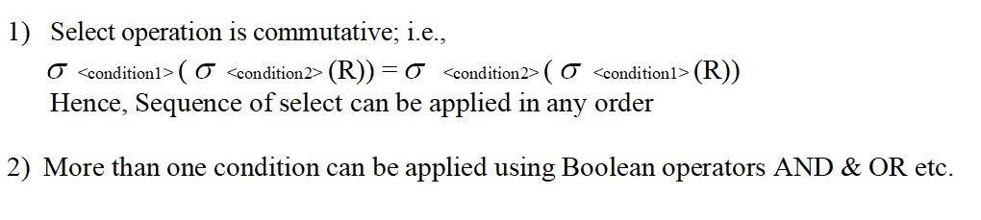
SELECT Operator (σ)

Slide 36
PROJECT Operator(π)
PROJECT operation can be thought of as eliminating unwanted columns. It is denoted by pie (π) symbol. The attributes needed to be appeared in the resultant relation appear as subscript to π.
The argument relation follows in parenthesis. The general syntax of project operator is:
π <attribute−list > (<relation name>)
Query: Find the loan numbers and respective loan amounts.
π loan_no,amount (Loan)
Loan
π loan_no, amount (Loan)
loan_no | branch_name | amount
L201 | Bhubaneswar Main | 50,000,000.00
L202 | Bhubaneswar Main | 5,000,000.00
L203 | Mumbai Main | 100,000,000.00
L204 | Juhu | 60,000,000.00
loan_no | amount
L201 | 50,000,000.00
L202 | 5,000,000.00
L203 | 100,000,000.00
L204 | 60,000,000.00

Slide 37
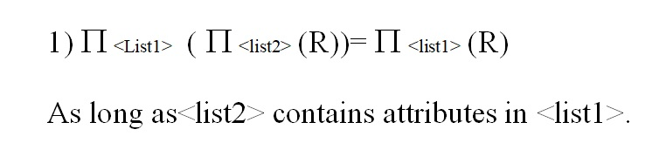
PROJECT Operator(π)

Slide 38
Composition of Relational Operators
Relational algebra operators can be composed together into a relational algebra expression to answer the complex queries.
Q: Find the name of the customers who live in Bhubaneswar.
Customer
cust_name | cust_street | cust_city
Rishi Sarthak Manas Ramesh Mahesh | India Gate M. G. Road Shastri Nagar M. G. Road Juhu | New Delhi Bangalore Bhubaneswar Bhubaneswar Mumbai
π cust _name (σ cust _city =′ Bhubaneswar ′ (Customer))
cust_name
Manas Ramesh

Slide 39
RENAME Operator(ρ)
The results of relational algebra expressions do not have a name that can be used to refer them. It is useful to be able to give them names; the rename operator is used for this purpose. It is denoted by rho (ρ) symbol.
The general syntax of rename operator is:
ρ X (E)
Assume E is a relational-algebra expression with arity n. The second form of rename operation is:
ρ X (b1 ,b2 ,...bn ) (E)
π cust _name (σ cust _city =′ Bhubaneswar ′ (Customer)) can be written as:
1. ρ Customer _Bhubaneswar (σ cust _city =′ Bhubaneswar ′ (Customer))
2. π _{cust _name} (Customer_Bhubaneswar)

Slide 40
RENAME Operator(ρ)…
The different forms of the rename operation for renaming the relation are:
a. ρ _{S} (R)
b. ρ S(b1 ,b2 ,...bn ) (R)
c. ρ (b ,b ,...b ) (R)
For example, the attributes of Customer (cust_name, cust_street, cust_city) can be renamed as:
^{ρ} (name,street ,city ) ^{(Customer)}

Slide 41
Basic Set Operation
These are the binary operations; i.e., each is applied to two sets or relations. These two relations should be union compatible except in case of Cartesian Product.
Two relations R (A1, A2,….., An) and S (B1, B2,……,Bn) are said to be union compatible if they have the same degree n and domains of the corresponding attributes are also the same i.e.Domain (Ai) = Domain (Bi) for 1<=i<=n.

Slide 42
Union Compatibility
To perform the set operations such as UNION, DIFFERENCE and INTERSECTION, the relations need to be union compatible for the result to be a valid relation.
Two relations R1(a1,a2,... an ) and R2(b1,b2,... bm ) are union compatible iff:
n = m, i.e. both relations have same arity(degree)
dom(ai ) = dom(bi ) for 1 ≤ i ≤ n

Slide 43
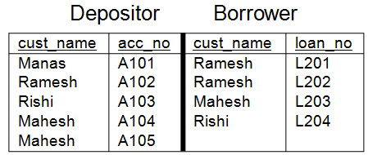
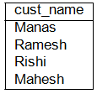
UNION Operator (∪)
The union operation is used to combine data from two relations. It is denoted by union(∪) symbol. The union of two relations R₁(a₁,a₂,... a_{n} ) and R₂(b₁,b₂,... b_{n} ) is a relation R₃ (c₁,c₂,... c_{n} ) such that:
dom(c_{i} ) = dom(a_{i} ) ∪ dom(b_{i} ), 1 ≤ i ≤ n
R₁ ∪ R₂ is a relation that includes all tuples that are either present in R₁ or R₂ or in both without duplicate tuples.
In other words, R3 will have tuples such that R3 = {t | R1 t v R2 t}
Q.Find the name of the customer who have loan or an account or both
π _{cust _name} (Depositor) ∪ π _{cust _name} (Borrower)

Slide 44
UNION Operator (∪): Rules
Conditions;
Duplicate tuples are eliminated automatically.
R and S must have the attribute of the same number.
Note: 1) Union is a commutative operation, i.e, R U S = S U R.
2) Union is an associative operation, i.e. R U (S U T) = (R U S) U T.

Slide 45

DIFFERENCE Operator(-)
The difference operation is used to identify the rows that are in one relation and not in another. It is denoted as (-) symbol. The difference of two relations R1(a1,a2,... an ) and R2(b1,b2,... bn ) is a relation R3 (c1,c2,... cn ) such that:
dom(ci ) = dom(ai ) - dom(bi ), 1 ≤ i ≤ n
R1 - R2 is a relation that includes all tuples that are in R1, but not in R2.
π _{cust _name} (Depositor) - π _{cust _name} (Borrower)

Slide 46
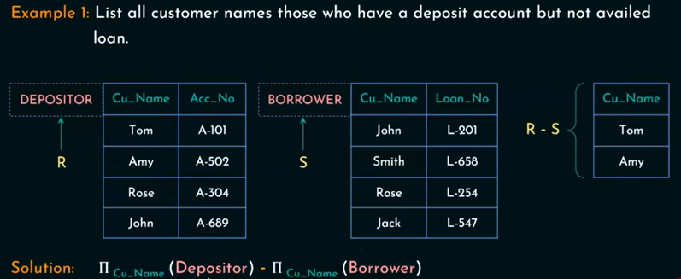

Slide 47
Cartesian Product Operator(×)
The Cartesian product of two relations R1(a1,a2,... an ) with cardinality i and R2(b1,b2,... bm ) with cardinality j is a relation R3 with
degree k = n + m,
cardinality i*j and
attributes (a1,a2,... an , b1,b2,... bm ))
R1 × R2 is a relation that includes all the possible combinations of tuples from R1 and R2. The Cartesian product is used to combine information from any two relations.
It is not a useful operation by itself; but is used in conjuction with other operations.

Slide 48
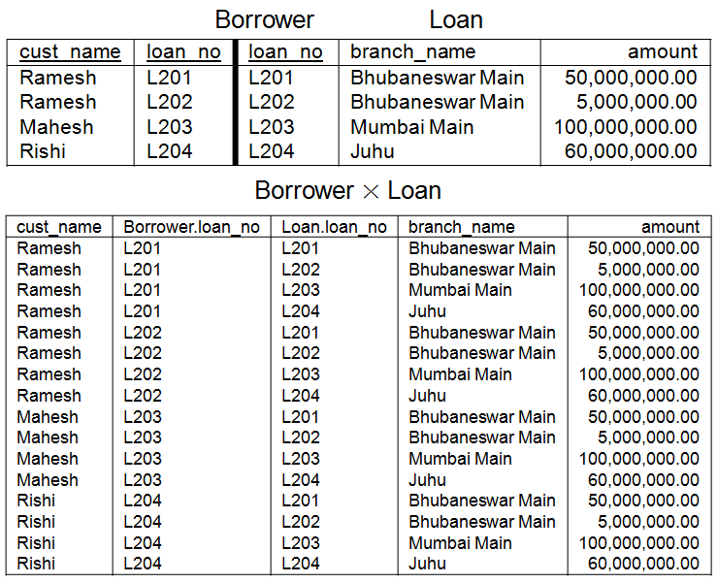
Cartesian Product Operator(×)…

Slide 49

Cartesian Product Operator(×)…
Query: Find out the customer and their loan details taken from Bhubaneswar Main branch.
Ans: σ branch_name = ′BhubaneswarMain′ AND Borrower.loan_no=Loan.loan_no (Borrower ×Loan)

Slide 50
Intersection Operator(∩)
The intersection operation is used to identify the rows that are common to two relations. It is denoted by (∩) symbol. The intersection of two relations R1 (a1,a2,... an ) and R2 (b1,b2,... bn ) is a relation R3 (c1,c2,... cn ) such that…
dom (ci ) = dom (ai ) ∩ dom (bi ), 1 ≤ i ≤ n
R1 ∩ R2 is a relation that includes all tuples that are present in both R1 and R2.
The intersection operation can be rewritten by a pair of set difference operations as R ∩ S = R - (R - S).

Slide 51
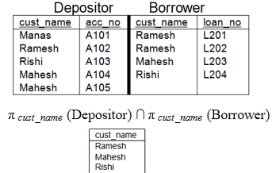

Slide 52
Division Operator (÷)
The division operation creates a new relation by selecting the rows in one relation that match every row in another relation. The division operation requires that we look at an entire relation at once. It is denoted by division (÷) symbol.
Let A, B, C are three relations and we desire B ÷ C to give A as the result. This operation is possible iff:
The columns of C must be a subset of the columns of B. The columns of A are all and only those columns of B that are not columns of C
A row is placed in A if and only if it is associated with B and with every row of C
The division operation is the reverse of the Cartesian product operation as: B = (B × C) ÷ C.
Division operator is suited to queries that include the phrase every or all as part of the condition.

Slide 53
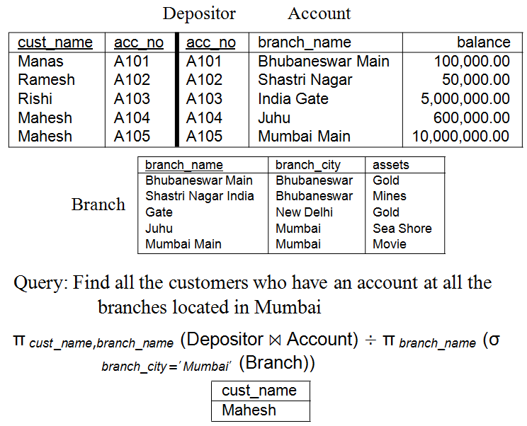
Division Operator (÷)…

Slide 54
Assignment Operator(←)
It works like assignment in a programming language. In relational algebra, the assignment operator gives a name to a relation. It is denoted by (←) symbol.
Assignment must always be made to a temporary relation variable. The result of the right of the ← symbol is assigned to the relation variable on the left of the ← symbol.
With the assignment operator, a query can be written as a sequential program consisting of:
a series of assignment,
followed by an expression whose value is displayed as a result of the query
π cust _name,branch_name (Depositor ⋊⋉ Account) ÷ π branch_name (σ
branch_city =′ Mumbai′ (Branch)) can be simplified as:
Temp1 ← π _{cust _name,branch_name} (Depositor ⋊⋉ Account)
Temp2 ← π branch_name (σ branch_city =′ Mumbai′ (Branch))
Result = Temp1 ÷ Temp2

Slide 55
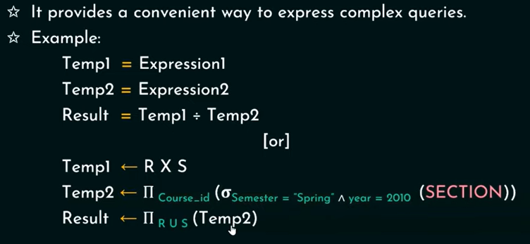

Slide 56
Join
The join operation is used to connect data across relations. Tables are joined on columns that have the same data type and data width in the tables.
Join operation joins two relations by merging those tuples from two relations that satisfy a given condition. The condition is defined on attributes belonging to relations to be joined.
Different categories of join are:
Inner Join
Outer Join
Self Join
Inner Join: In the inner join, tuples with NULL valued join attributes do not appear in the result. Tuples with NULL values in the join attributes are also eliminated. The different types of inner join are:
Theta Join
Equi Join
Natural Join

Slide 57
JOIN (⋈)
A Join operation combines related tuples from different relations, if and only if a given join condition is satisfied. It is denoted by ⋈.
Join is a combination of a Cartesian product followed by a selection process. A Join operation pairs two tuples from different relations, if and only if a given join condition is satisfied.
Operation: (EMPLOYEE ⋈ SALARY)
EXAMPLE:Employee Salary
EMP_CODE | EMP_NAME
101 | Stephan
102 | Jack
103 | Harry
EMP_CODE | SALARY
101 | 50000
102 | 30000
103 | 25000

Slide 58
JOIN Operator(⋈)
Result Table:
EMP_CODE | EMP_NAME | SALARY
101 | Stephan | 50000
102 | Jack | 30000
103 | Harry | 25000

Slide 59
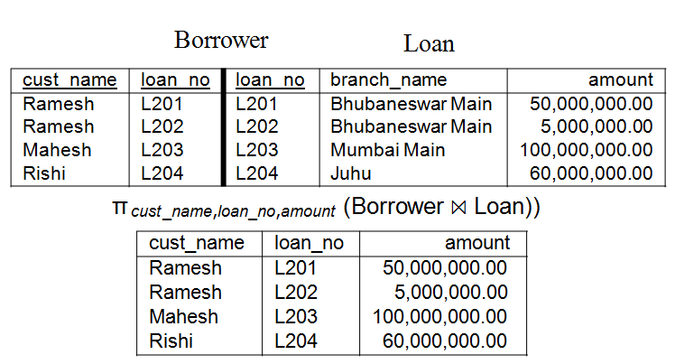
JOIN Operator(⋈)…

Slide 60
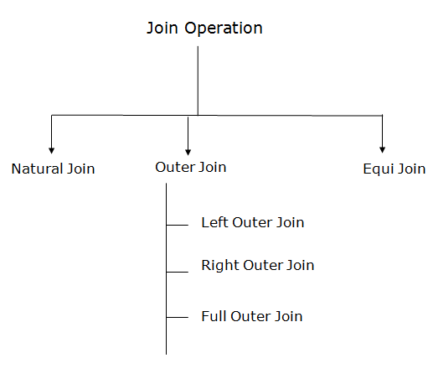
Types of Join operations:

Slide 61
Theta join
Theta join combines tuples from different relations provided they satisfy the theta condition. The join condition is denoted by the symbol θ.
When each condition is of the form A θB, A is an attribute of R1 and B is an attribute of R2 and have the same domain, and  is one of the comparison operators { ==, =, <=, <,=>,>}.

Slide 62
Theta Join( θ )
The theta join is a join with a specified condition involving a column from each relation. This condition specifies that the two columns should be compared in some way.
The comparison operator can be any of the six: <, ≤, >, ≥, = and ^ =
Theta join is denoted by (⋊⋉ θ) symbol. The general form of theta join is:
R ⋊⋉ θ S = π all (σ θ (R × S))
Degree (Result) = Degree (R) + Degree (S)
Cardinality (Result) ≤ Cardinality(R) × Cardinality(S)

Slide 63
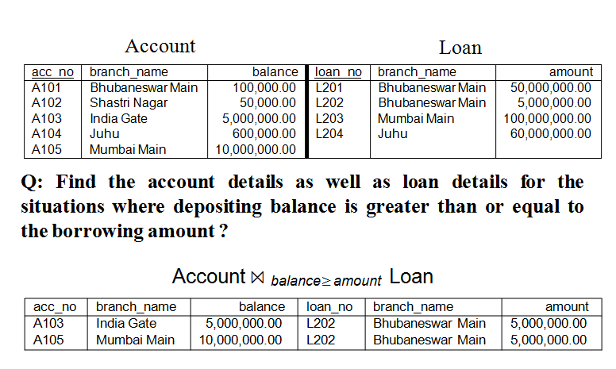
Theta Join( θ )…

Slide 64
1. Natural Join(⋈,*):
A natural join is the set of tuples of all combinations in R and S that are equal on their common attribute names.
It is denoted by ⋈.
Example: Let's use the above EMPLOYEE table and SALARY table:
Example:
∏EMP_NAME, SALARY (EMPLOYEE ⋈ SALARY)
EMP_CODE | EMP_NAME
101 | Stephan
102 | Jack
103 | Harry
EMP_CODE | SALARY
101 | 50000
102 | 30000
103 | 25000
EMP_NAME | SALARY
Stephan | 50000
Jack | 30000
Harry | 25000

Slide 65
Natural Join ( ,* )
To perform natural join on two relations, they should contain at least one common attributes. It is just like the equi join with the elimination of the common attributes. The natural join is denoted by (⋊⋉) symbol.
The general form of theta join is:
R ⋊⋉ S = Π all−common_attributes (σ = (R × S))
Degree (Result) = Degree (R) + Degree (S) - Degree (R ∩S)
Cardinality (Result) ≤ Cardinality(R) × Cardinality(S)
The general form of the natural join can also be represented as:
R ⋊⋉ S = Π all (R ⋊⋉ S)

Slide 66
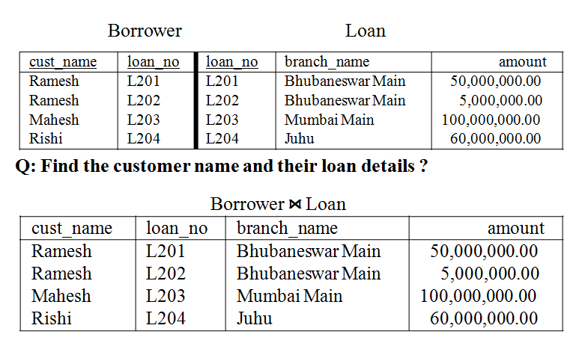
Natural Join ( ,*)

Slide 67
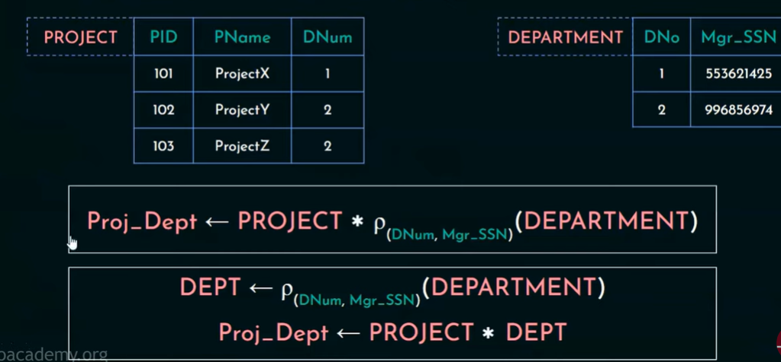
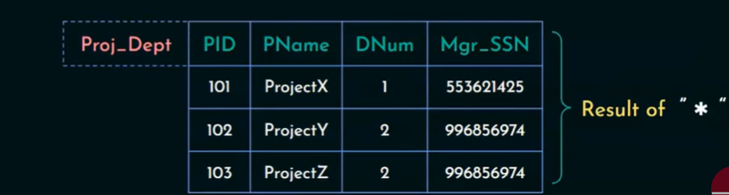
Example

Slide 68
2. Outer Join:
The outer join operation is an extension of the join operation. It is used to deal with missing information.
EMPLOYEE ⋈ FACT_WORKERS
Example: EMPLOYEE FACT_WORKERS
EMP_NAME | STREET | CITY
Ram | Civil line | Mumbai
Shyam | Park street | Kolkata
Ravi | M.G. Street | Delhi
Hari | Nehru nagar | Hyderabad
EMP_NAME | BRANCH | SALARY
Ram | Infosys | 10000
Shyam | Wipro | 20000
Kuber | HCL | 30000
Hari | TCS | 50000
EMP_NAME | STREET | CITY | BRANCH | SALARY
Ram | Civil line | Mumbai | Infosys | 10000
Shyam | Park street | Kolkata | Wipro | 20000
Hari | Nehru nagar | Hyderabad | TCS | 50000

Slide 69
Outer Join
It is an extension of the natural join operation to deal with the missing information. The outer join consists of two steps:
First, a natural join is executed
Then if any record in one relation does not match a record from the other relation in the natural join, that unmatched record is added to the join relation, and the additional columns are filled with NULLs
The different types of outer join are:
Left Outer Join
Right Outer Join
Full Outer Join

Slide 70
Left Outer Join(⟕)
An outer join is basically of three types:
Left outer join
Right outer join
Full outer join
Left outer join
Left outer join contains the set of tuples of all combinations in R and S that are equal on their common attribute names.
In the left outer join, tuples in R have no matching tuples in S.
It is denoted by ⟕.
Example: Using the above EMPLOYEE table and FACT_WORKERS table

Slide 71
Left Outer Join(⟕)
EMP_NAME | STREET | CITY | BRANCH | SALARY
Ram | Civil line | Mumbai | Infosys | 10000
Shyam | Park street | Kolkata | Wipro | 20000
Hari | Nehru street | Hyderabad | TCS | 50000
Ravi | M.G. Street | Delhi | NULL | NULL

Slide 72
Left Outer Join
The left outer join preserves all tuples in left relation. The left outer join is denoted by symbol:
All information from the left relation is present in the result of the left outer join.

Slide 73
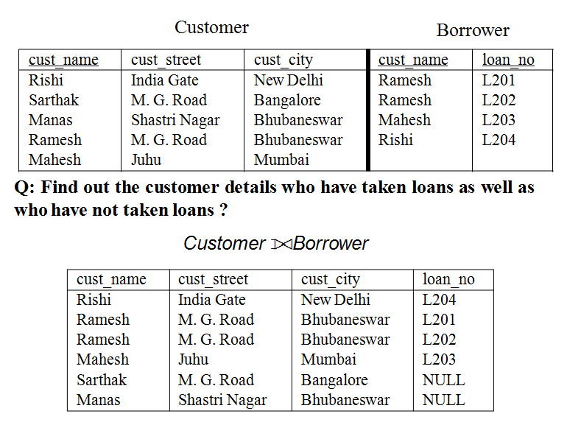
Left Outer Join

Slide 74
Right outer join:( ⟖)
Right outer join contains the set of tuples of all combinations in R and S that are equal on their common attribute names
In right outer join, tuples in S have no matching tuples in R.
It is denoted by ⟖.
Example: Using the above EMPLOYEE table and FACT_WORKERS Relation
EMPLOYEE ⟖ FACT_WORKERS
EMP_NAME | BRANCH | SALARY | STREET | CITY
Ram | Infosys | 10000 | Civil line | Mumbai
Shyam | Wipro | 20000 | Park street | Kolkata
Hari | TCS | 50000 | Nehru street | Hyderabad
Kuber | HCL | 30000 | NULL | NULL

Slide 75
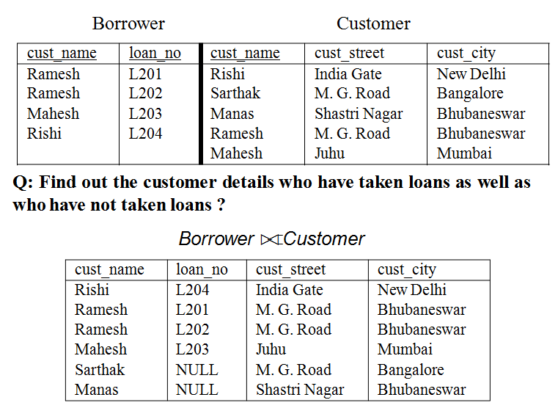
Right Outer Join
The right outer join preserves all tuples in right relation. The right outer join is denoted by symbol:
All information from the right relation is present in the result of the right outer join.

Slide 76
Full outer join:(⟗)
Full outer join is like a left or right join except that it contains all rows from both tables.
In full outer join, tuples in R that have no matching tuples in S and tuples in S that have no matching tuples in R in their common attribute name.
It is denoted by ⟗.
Example: Using the above EMPLOYEE table and FACT_WORKERS table
Input:
EMPLOYEE ⟗ FACT_WORKERS
EMP_NAME | STREET | CITY | BRANCH | SALARY
Ram | Civil line | Mumbai | Infosys | 10000
Shyam | Park street | Kolkata | Wipro | 20000
Hari | Nehru street | Hyderabad | TCS | 50000
Ravi | M.G. Street | Delhi | NULL | NULL
Kuber | NULL | NULL | HCL | 30000

Slide 77
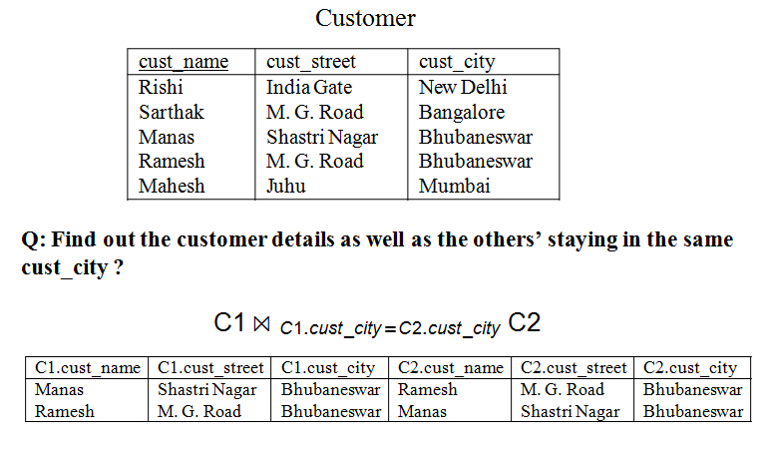
Full Outer Join
The full outer join preserves all tuples in both relations. The full outer join is denoted by symbol:
All information from both the relations is present in the result of the full outer join.

Slide 78
3. Equi join:
It is also known as an inner join. It is the most common join. It is based on matched data as per the equality condition. The equi join uses the comparison operator(=).
CUSTOMER RELATION PRODUCT
CUSTOMER ⋈ PRODUCT
CLASS_ID | NAME
1 | John
2 | Harry
3 | Jackson
PRODUCT_ID | CITY
1 | Delhi
2 | Mumbai
3 | Noida
CLASS_ID | NAME | PRODUCT_ID | CITY
1 | John | 1 | Delhi
2 | Harry | 2 | Mumbai
3 | Harry | 3 | Noida

Slide 79
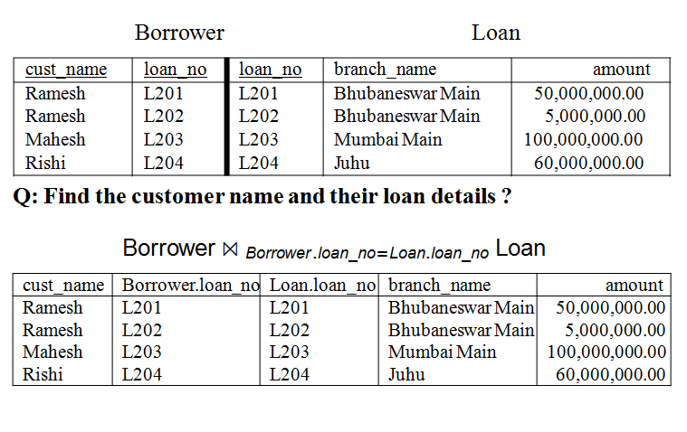
Equi Join( = )
The equi join is the theta join based on equality of specified columns. That means the equi join is the special type of theta join where the comparison operator is =.
The general form of theta join is: R ⋊⋉ ₌ S = π _{all} (σ ₌ (R × S))
Degree (Result) = Degree (R) + Degree (S)
Cardinality (Result) ≤ Cardinality(R) × Cardinality(S)

Slide 80

Self Join
The self join is similar to the theta join. It joins a relation to itself by a condition. The self join can be viewed as a join of two copies of the same relation.
The general form of self join is:
Thus, the self join creates two alias or copies of the same relation; then performs the theta join by a condition based on the attributes of these two copies.

Slide 81
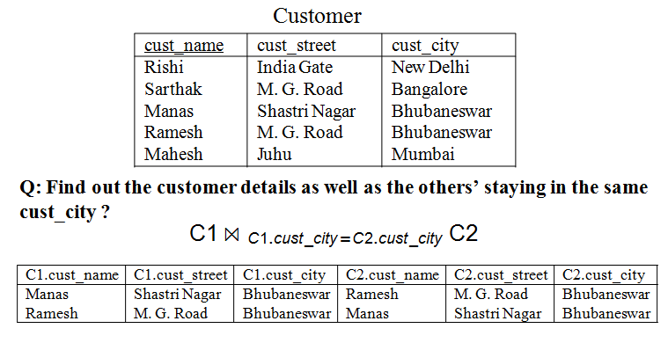
Self Join

Slide 82
Generalized Projection
The generalized-projection operation extends the projection operation by allowing arithmetic functions to be used in the projection list. The general form of generalized-projection is:
π F₁ ,F₂ ...F_{n} (E)
Ex: Emp=(ssn, salary, deduction, years_service) be a relation. A report may be required to show net_salary=salary-deduction, bonus=2000*years_service and tax=0.25*salary
^{REPORT ← ρ} (ssn,net _salary ,bonus,tax ) ^{(π} ssn,salary−deduction, 2000∗years_service, 0.25 ∗salary (Emp))

Slide 83
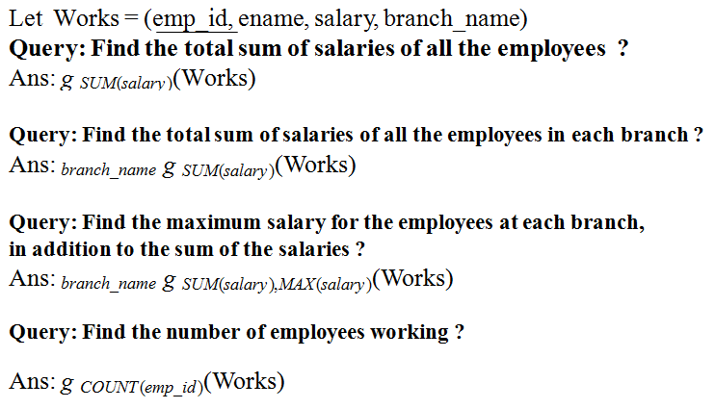
Aggregate Functions (g)
Aggregate functions take a collection of values and return a single value as a result. NULL value will not participate in the aggregate functions. The general form of aggregate function is:
grouping_attribute g aggregate_functions (R)

Slide 84
First Schema
Suppliers(sID, sName, address)
Parts(pID, pName, colour)
Catalog(sID, pID, price)
Catalog[sID] ⊆ Suppliers[sID]
Catalog[pID] ⊆ Parts[pID]
Q1. Find the sIDs of all suppliers who supply a part that is red or green.

Slide 85
Find the names of all red parts.
Find the sIDs of all suppliers who supply a part that is red or green.
Find the names of all suppliers who supply a part that is red or green

Slide 87
Employees(number, name, age, salary)
Supervises(boss, employee)
Supervises[boss] ⊆ Employees[number]
Supervises[employee] ⊆ Employees[number]
Q1. Find the names and salaries of all bosses who have an employee earning more than 100.
Hint: Below each subexpression, write the names of the attributes in the resulting relation.

Slide 89
Clients(CID, name, phone)
Staff(SID, name)
Appointments(CID, date, time, service, SID)
Appointments[CID] ⊆ Clients[CID]
Appointments[SID] ⊆ Staff[SID]
Find the appointment time and client name of all appointments for staff member Giuliano on Feb14. (Assume that you can compare a date value to “Feb 14” using “=”). At each step, use projection to pare down to only the attributes you need.

Slide 91
Question:
Consider the following relational database schema consisting of the four relation schemas:
passenger ( pid, pname, pgender, pcity)
agency ( aid, aname, acity)
flight (fid, fdate, time, src, dest)
booking (pid, aid, fid, fdate)
Answer the following questions using relational algebra queries;

Slide 92
Null Values
Null values in databases pose challenges in operations like arithmetic, comparisons, and set operations. In arithmetic expressions, if any input is null, the result is null. Comparisons involving nulls are tricky; SQL considers them unknown, creating a third logical value. For instance, "1 < null" is neither true nor false, but unknown. Boolean operations in where clauses also deal with the unknown value, complicating queries.
and: The result of true and unknown is unknown, false and unknown is false, while unknown and unknown is unknown.
or: The result of true or unknown is true, false or unknown is unknown, while unknown or unknown is unknown.
not: The result of not unknown is unknown.

Slide 93
the evaluation of expressions involving null values can lead to results of "unknown." For instance, when checking if r.A is null, both conditions "1 < r.A" and "not (1 < r.A)" will evaluate to unknown if r.A is null. In the context of a WHERE clause, tuples that result in either false or unknown for the predicate are not included in the query result.
To identify instructors with null values for salary, you can use the SQL query:
SELECT name
FROM instructor
WHERE salary IS NULL;

Slide 94
The special keyword null is employed in predicates to test for null values. The predicate "is not null" succeeds if the value being examined is not null. Additionally, SQL provides the options to test whether the result of a comparison is unknown or not unknown using the clauses is unknown and is not unknown, respectively:
SELECT name
FROM instructor
WHERE salary > 10000 IS UNKNOWN;
When utilizing the SELECT DISTINCT clause, duplicate tuples are eliminated. In this process, when comparing attribute values between tuples, the values are considered identical if both are non-null and equal or both are null. This means that two tuples with null values, such as {('A', null), ('A', null)}, are treated as identical, and only one copy is retained. It's important to note that this treatment of null differs from its treatment in predicates, where a comparison like "null=null" results in unknown rather than true.
The approach of treating tuples as identical when they have the same values for all attributes, even if some are null, is also applied in set operations like union, intersection, and except.

Slide 95
Nested Subqueries
SQL provides a mechanism for nesting subqueries. A subquery is a select-from-whereexpression that is nested within another query. A common use of subqueries is to perform tests for set membership, make set comparisons, and determine set cardinality by nesting subqueries in the where clause
Set Membership
Set Comparison
Test for Empty Relations
Test for the Absence of Duplicate Tuples
Subqueries in the From Clause
The With Clause
Scalar Subqueries
Scalar Without a From Clause

